Slide 1



ImageCLEF 2021 Tuberculosis - TBT classification
Group Members
Abdullah Al Mahfuj Shaan
Mahin Hassan

Slide 2
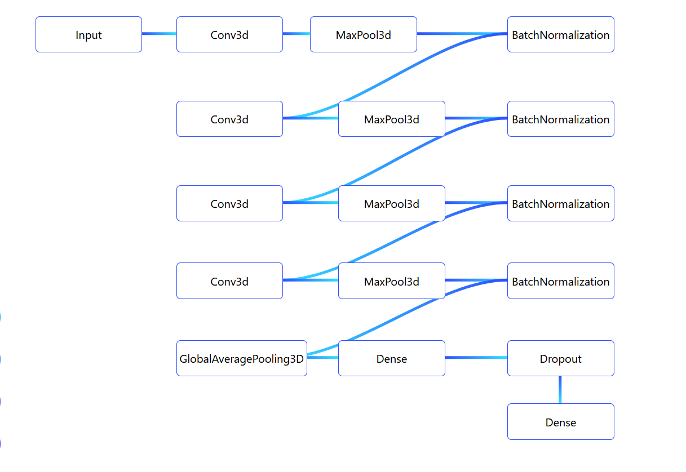
Design of the project

Slide 3
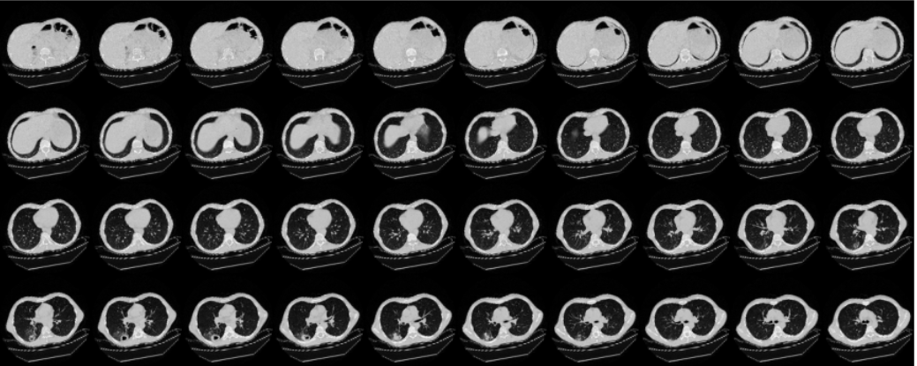
Visualization of the data CT Images after resizing

Slide 4
Contribution of the members
Data Visualization, Data Splitting, Data PreProcessing- Shaan
Model Building and Model Tune – Mahin Hassan

Slide 5
Teamwork
A few issues were faced while splitting the data into test and train tests. As it was a multiclass classification, we faced problems while assigning each of the TB types into different numpy arrays, both of us solved it later on.
The Deep Learning model is small but there are some issues which gave us wrong results, we still could not fix it.

Slide 6
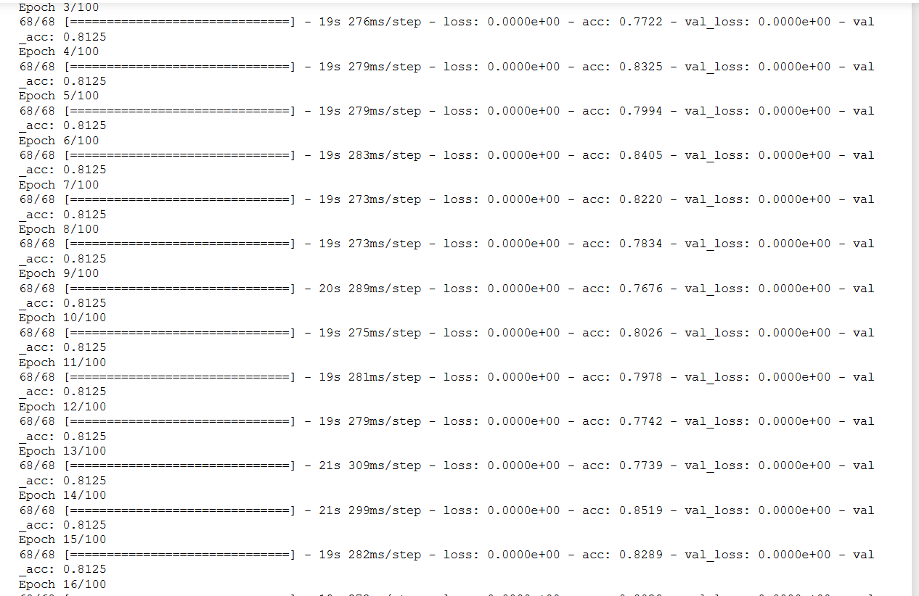
Results Analysis

Slide 7
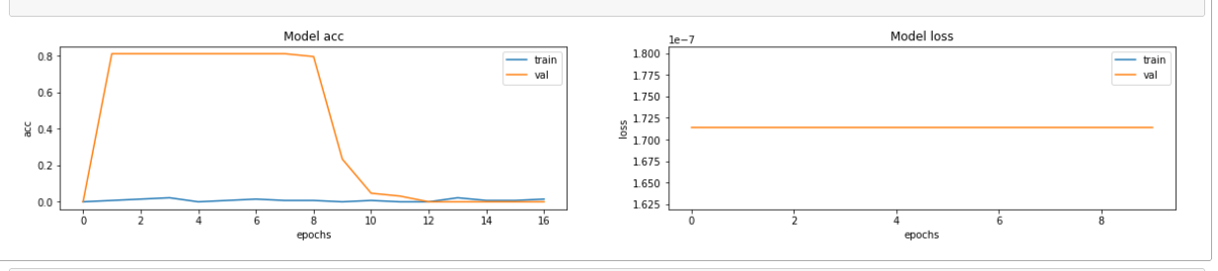
Results Analysis

Slide 8
Future Works
Model re-build and re-tune. Also work on a few other models if possible.
Fix the evaluation metrics
If the results are satisfactory, then we will read some more related works and start with the article.

Slide 9
Thank You

